Slide 1
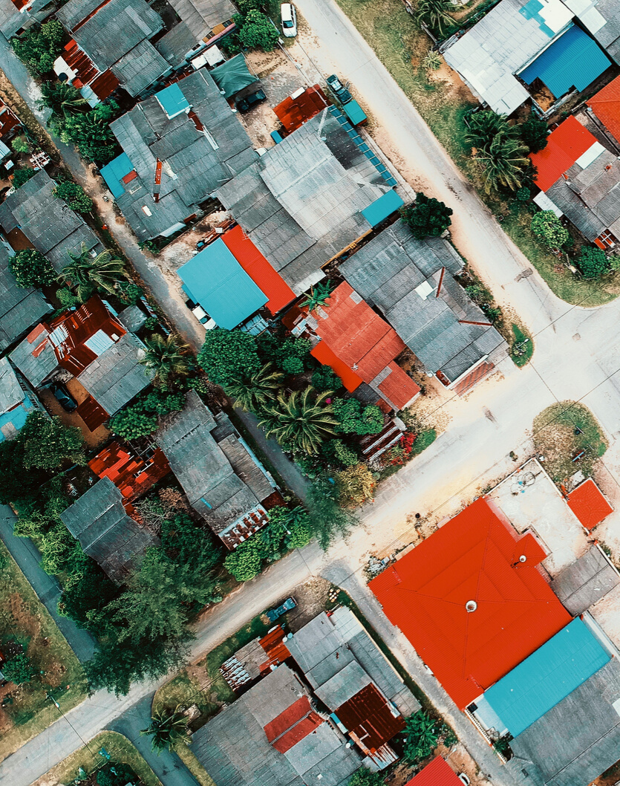
Engineers Without Borders
BIERHAUS SOLUTIONS
Making information accessible

Slide 2
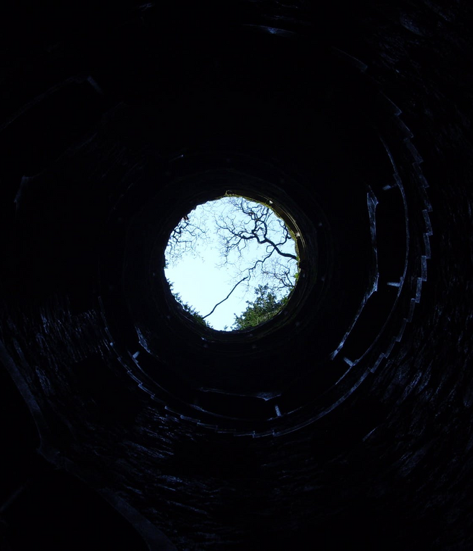
DID YOU KNOW?
50,000
Boreholes and wells in Africa are in disrepair
$360 million
Estimated loss of capital
Source:The International Institute for Environment and Development

Slide 3
PROBLEM
Missing information!

Slide 4

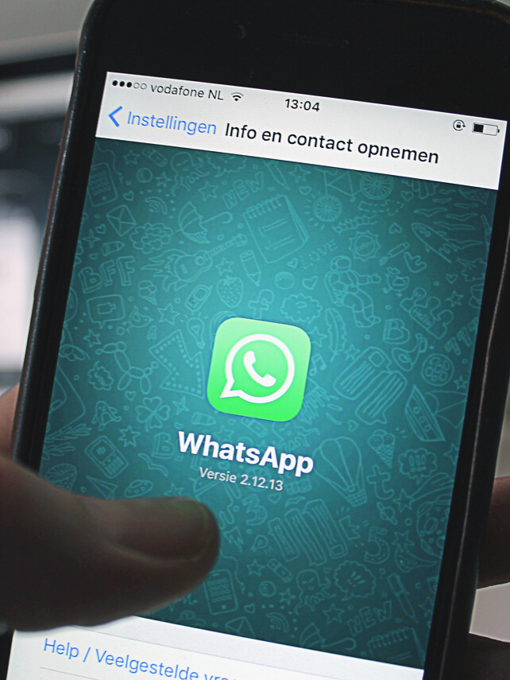
EWB’s EXISTING SOLUTIONS
No management system in place

Slide 5
People don’t know who to contact
Cumbersome process
Loss of motivation

Slide 6
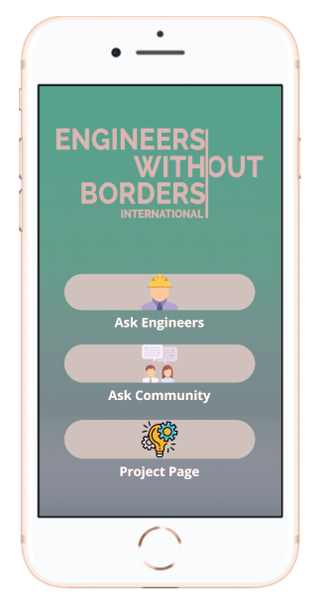
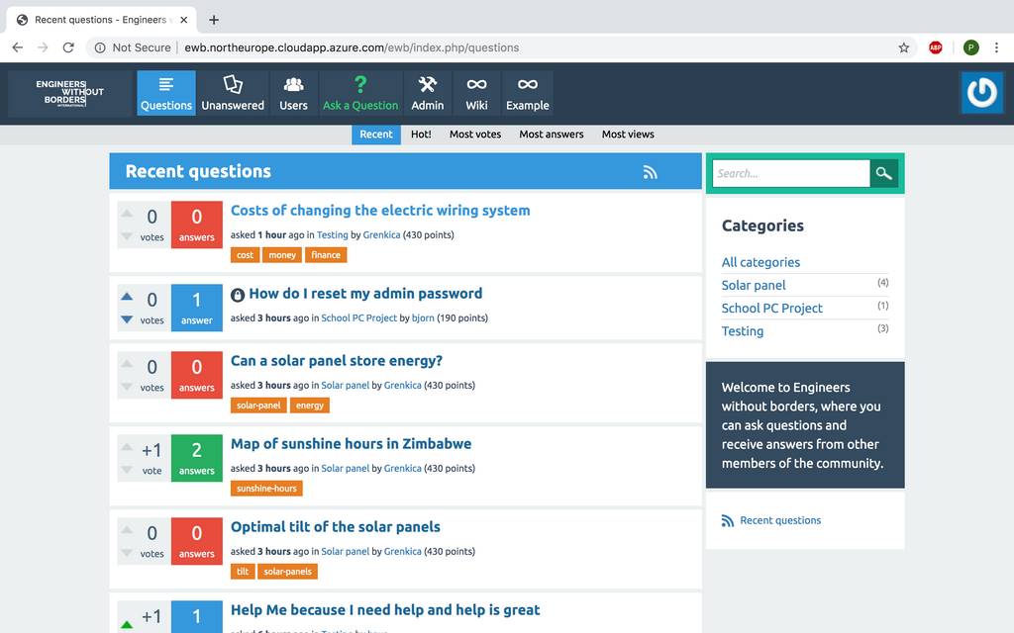
OUR SOLUTION
Mobile App
Web App

Slide 7
Product Demo
How does the website work?

Slide 8
Product Demo
How does the app work?

Slide 9


Slide 10
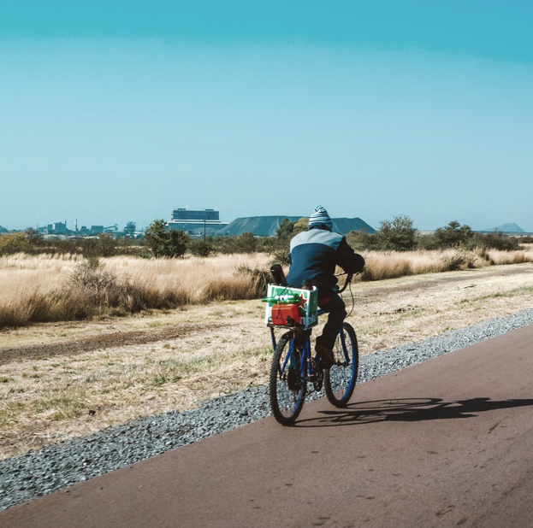


VALUE PROPOSITIONS
How are we better?
AVAILABLE OFFLINE
ORGANISED INFORMATION
COMMUNITY
BUILDING

Slide 11
THANK YOU

